Slide 1
“Stressed-out” agents
Workshop – 14-16/02/2017

Slide 2
Basic principle: agent-based model
Agent-Based Model is a computational model for simulating the actions and interactions of autonomous agents.
The basic idea is to use the ABM into a physical system, where the agents are objects created by sources that follows laws in terms of interaction, attraction and repulsion.

Slide 3
Approach 1

Slide 4
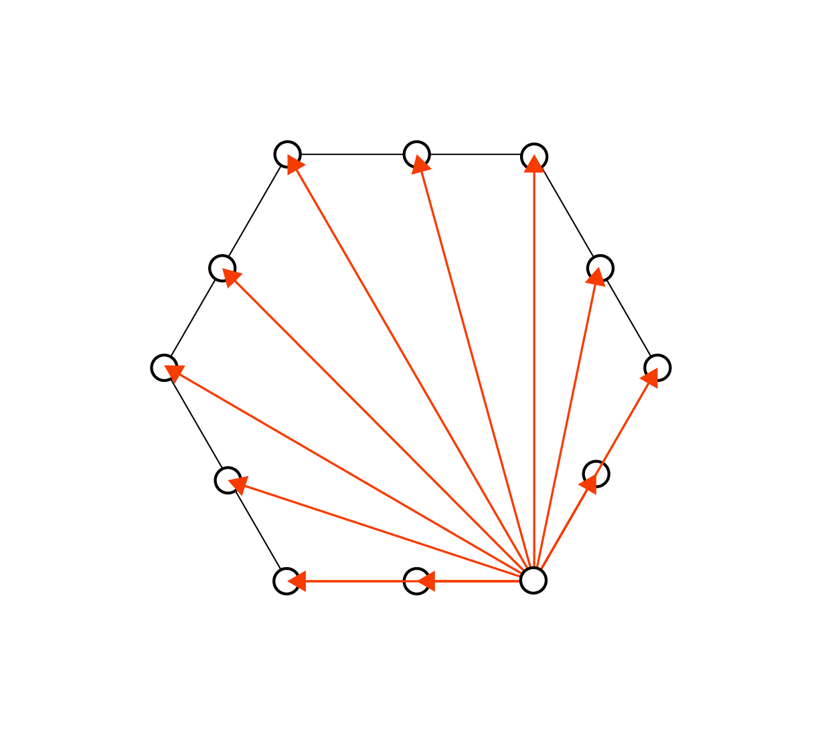
Phase 0
Sources along a fixed boundary
Each source generates a fixed number of agents, that corresponds to the same as the number of other sources
Each other source is an attraction for the agents

Slide 5
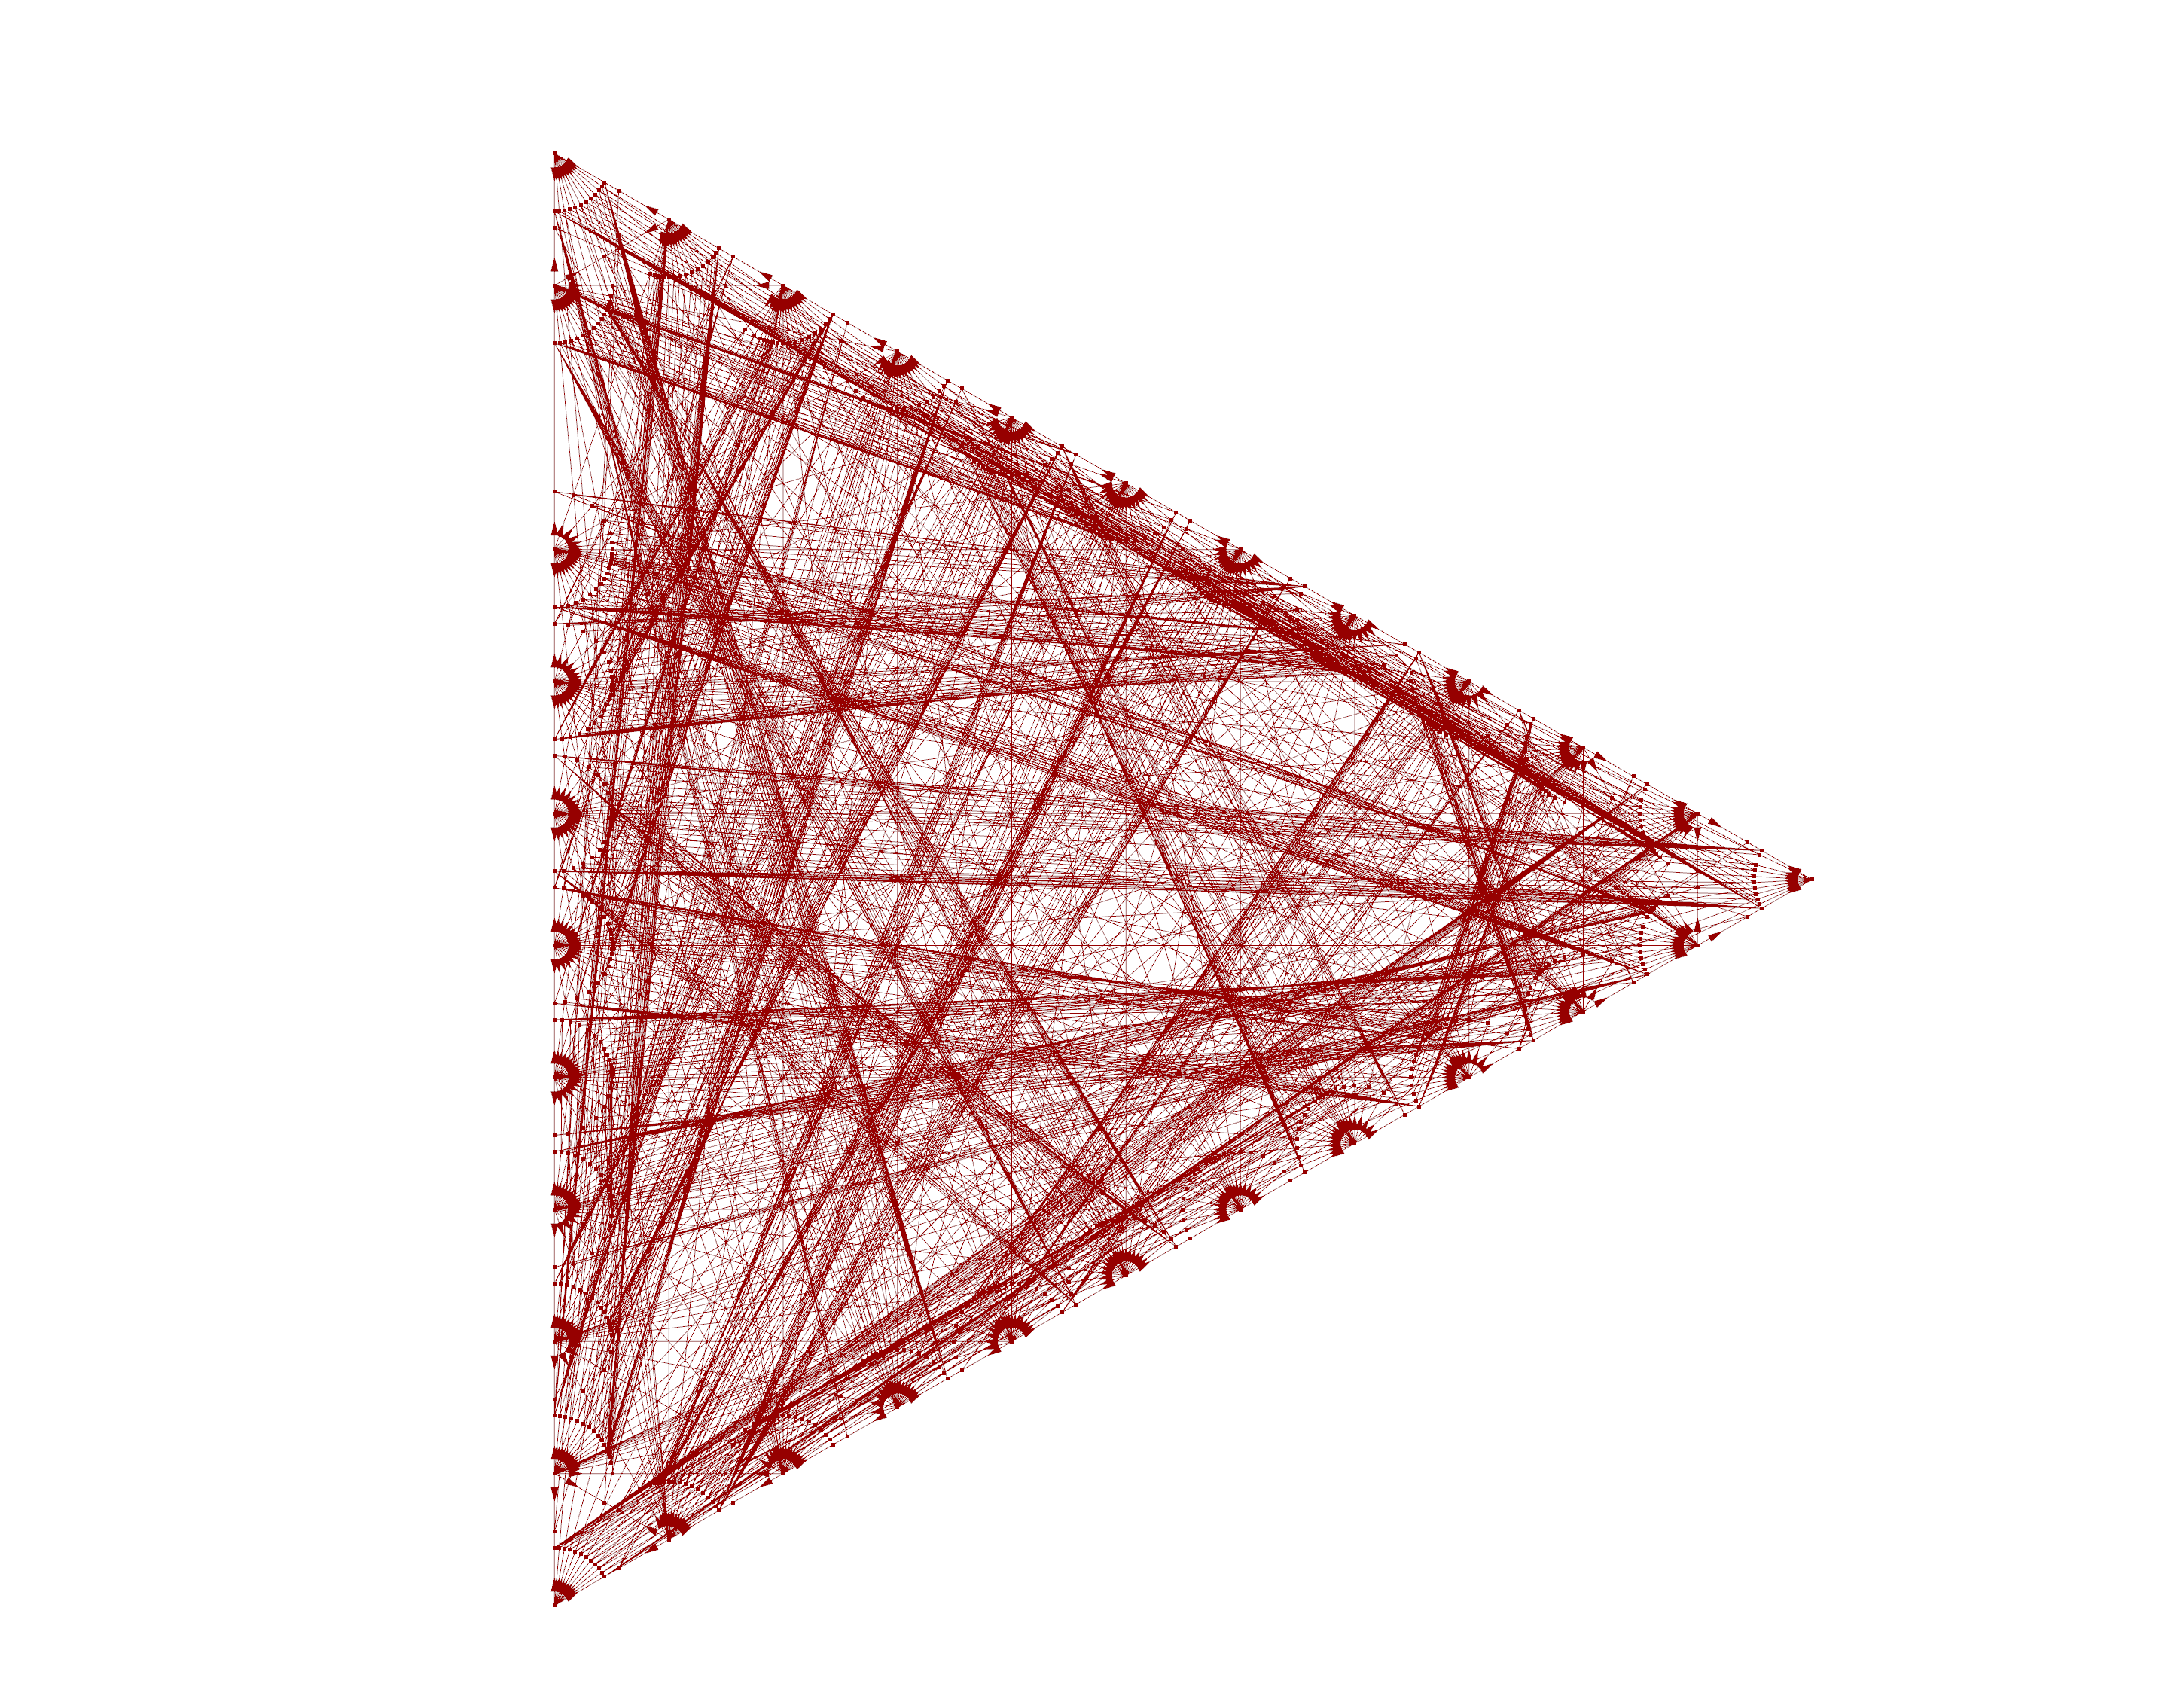
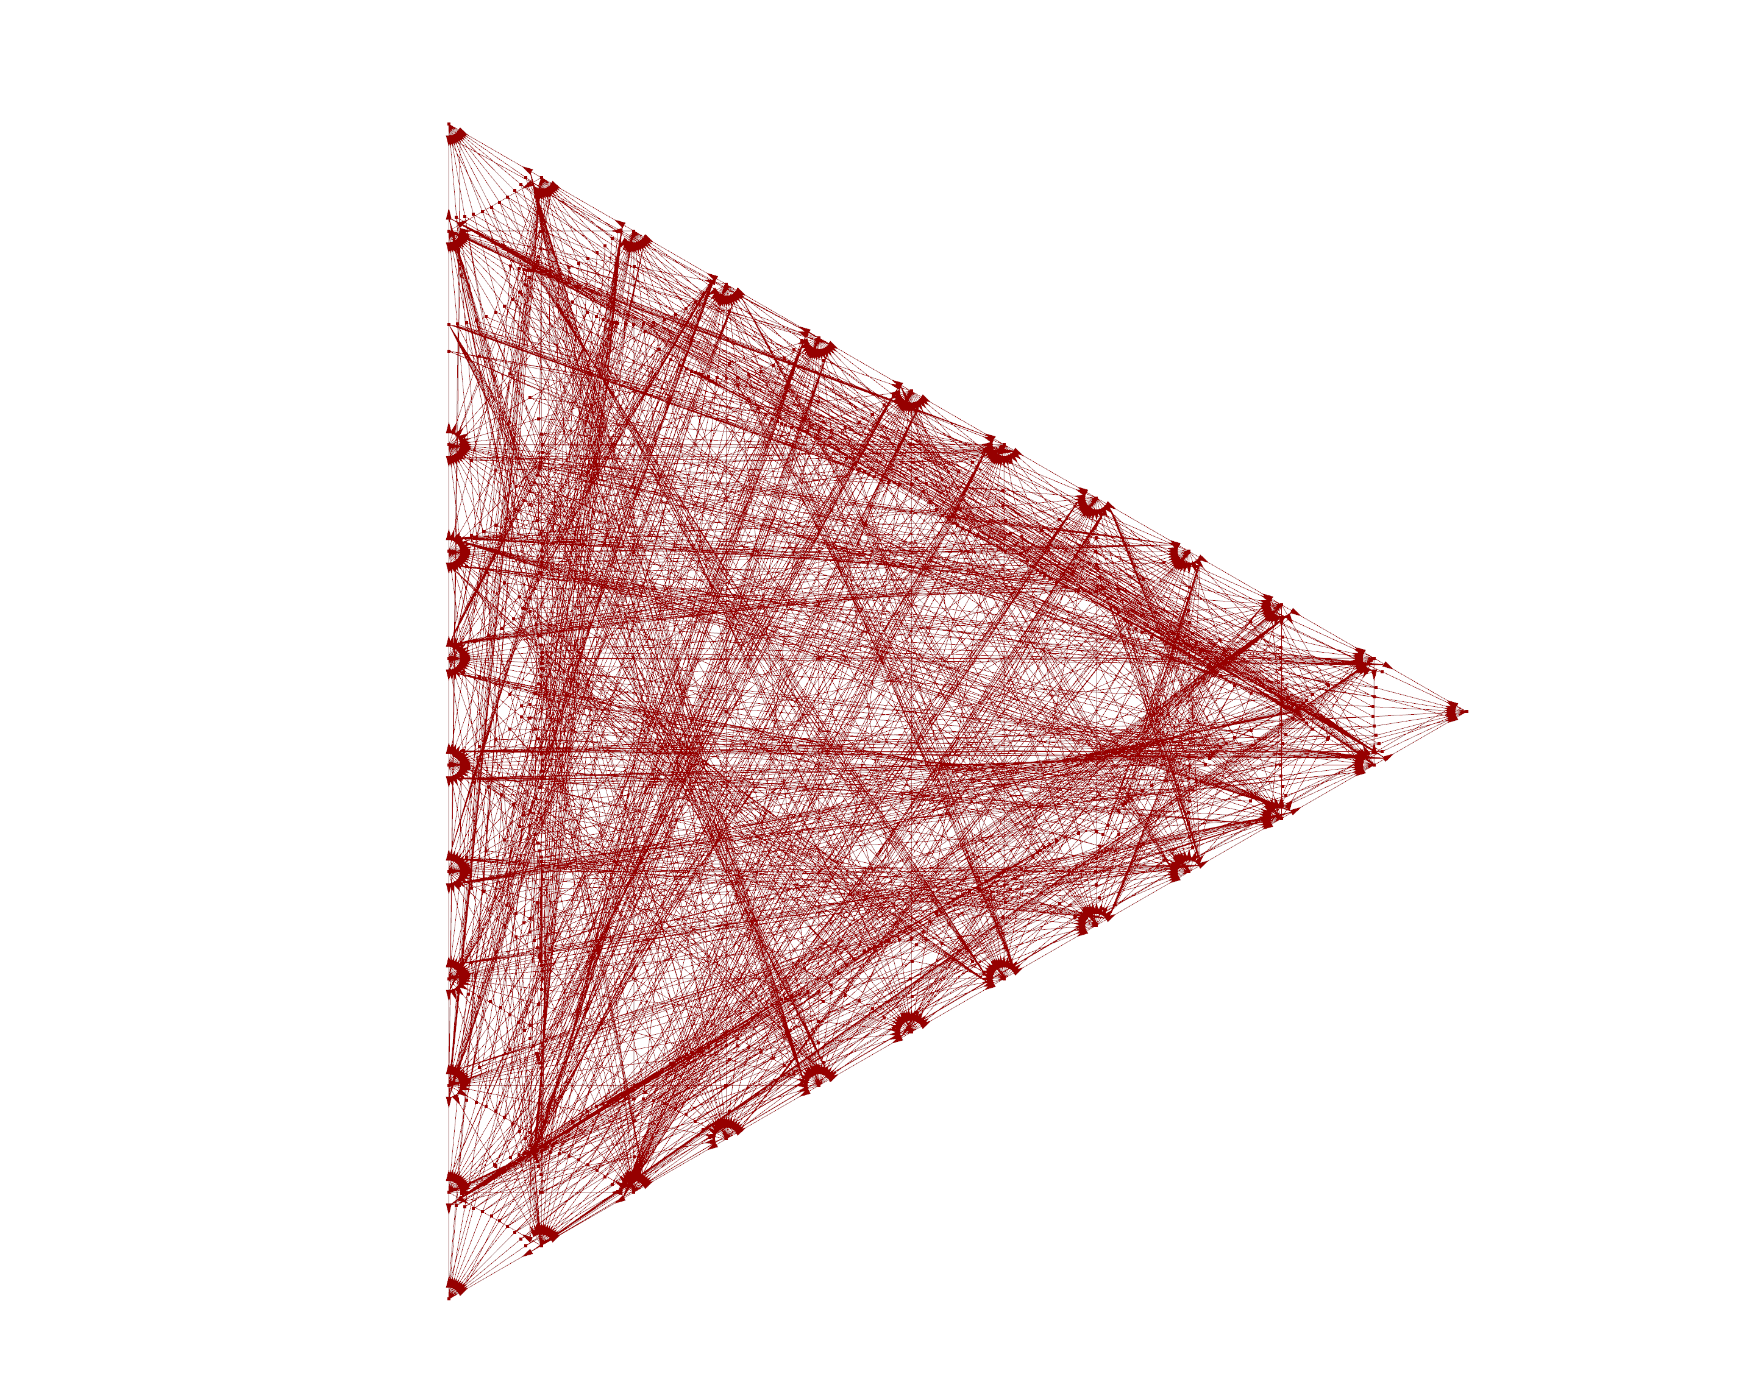
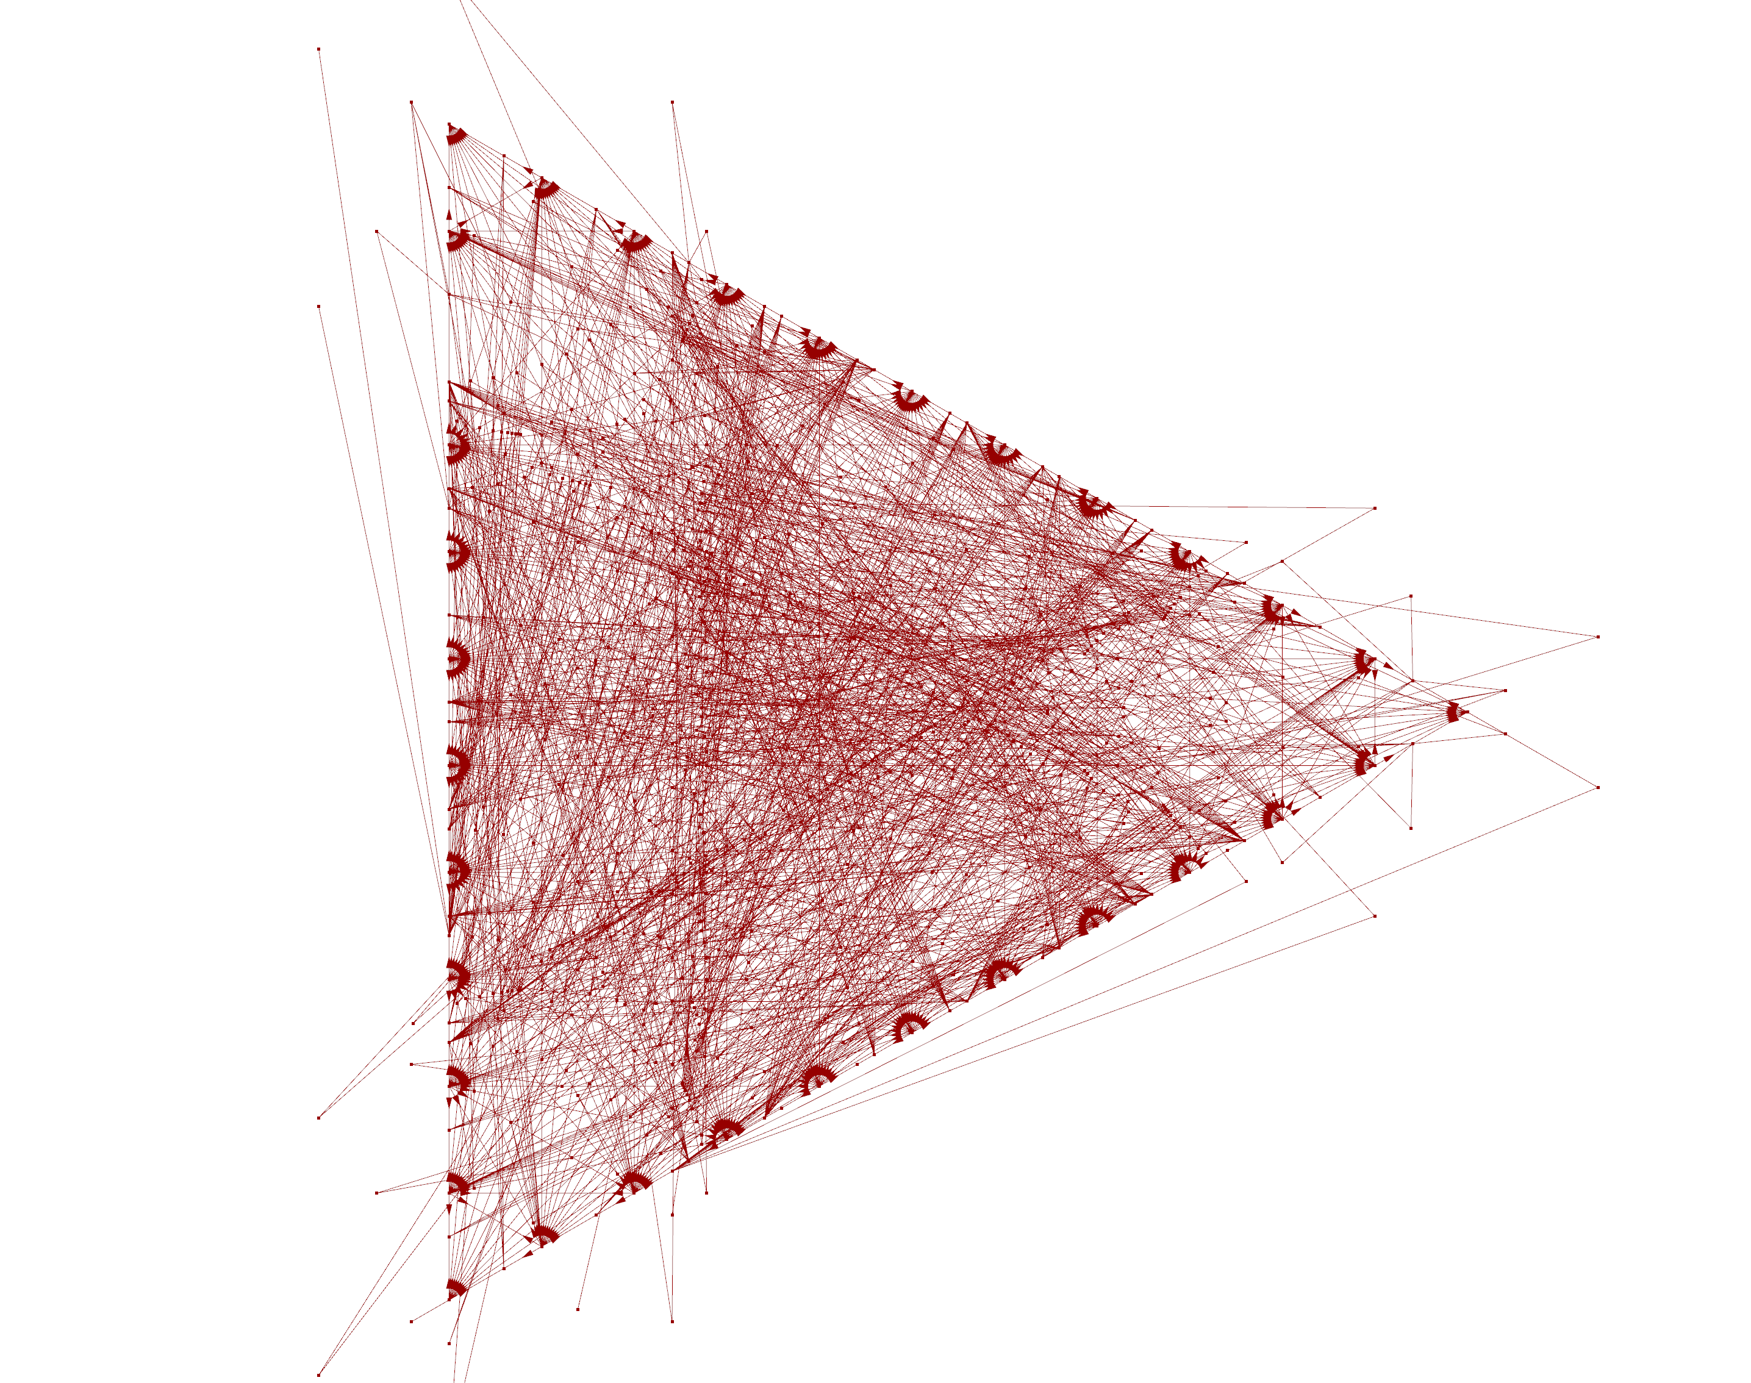

Slide 6
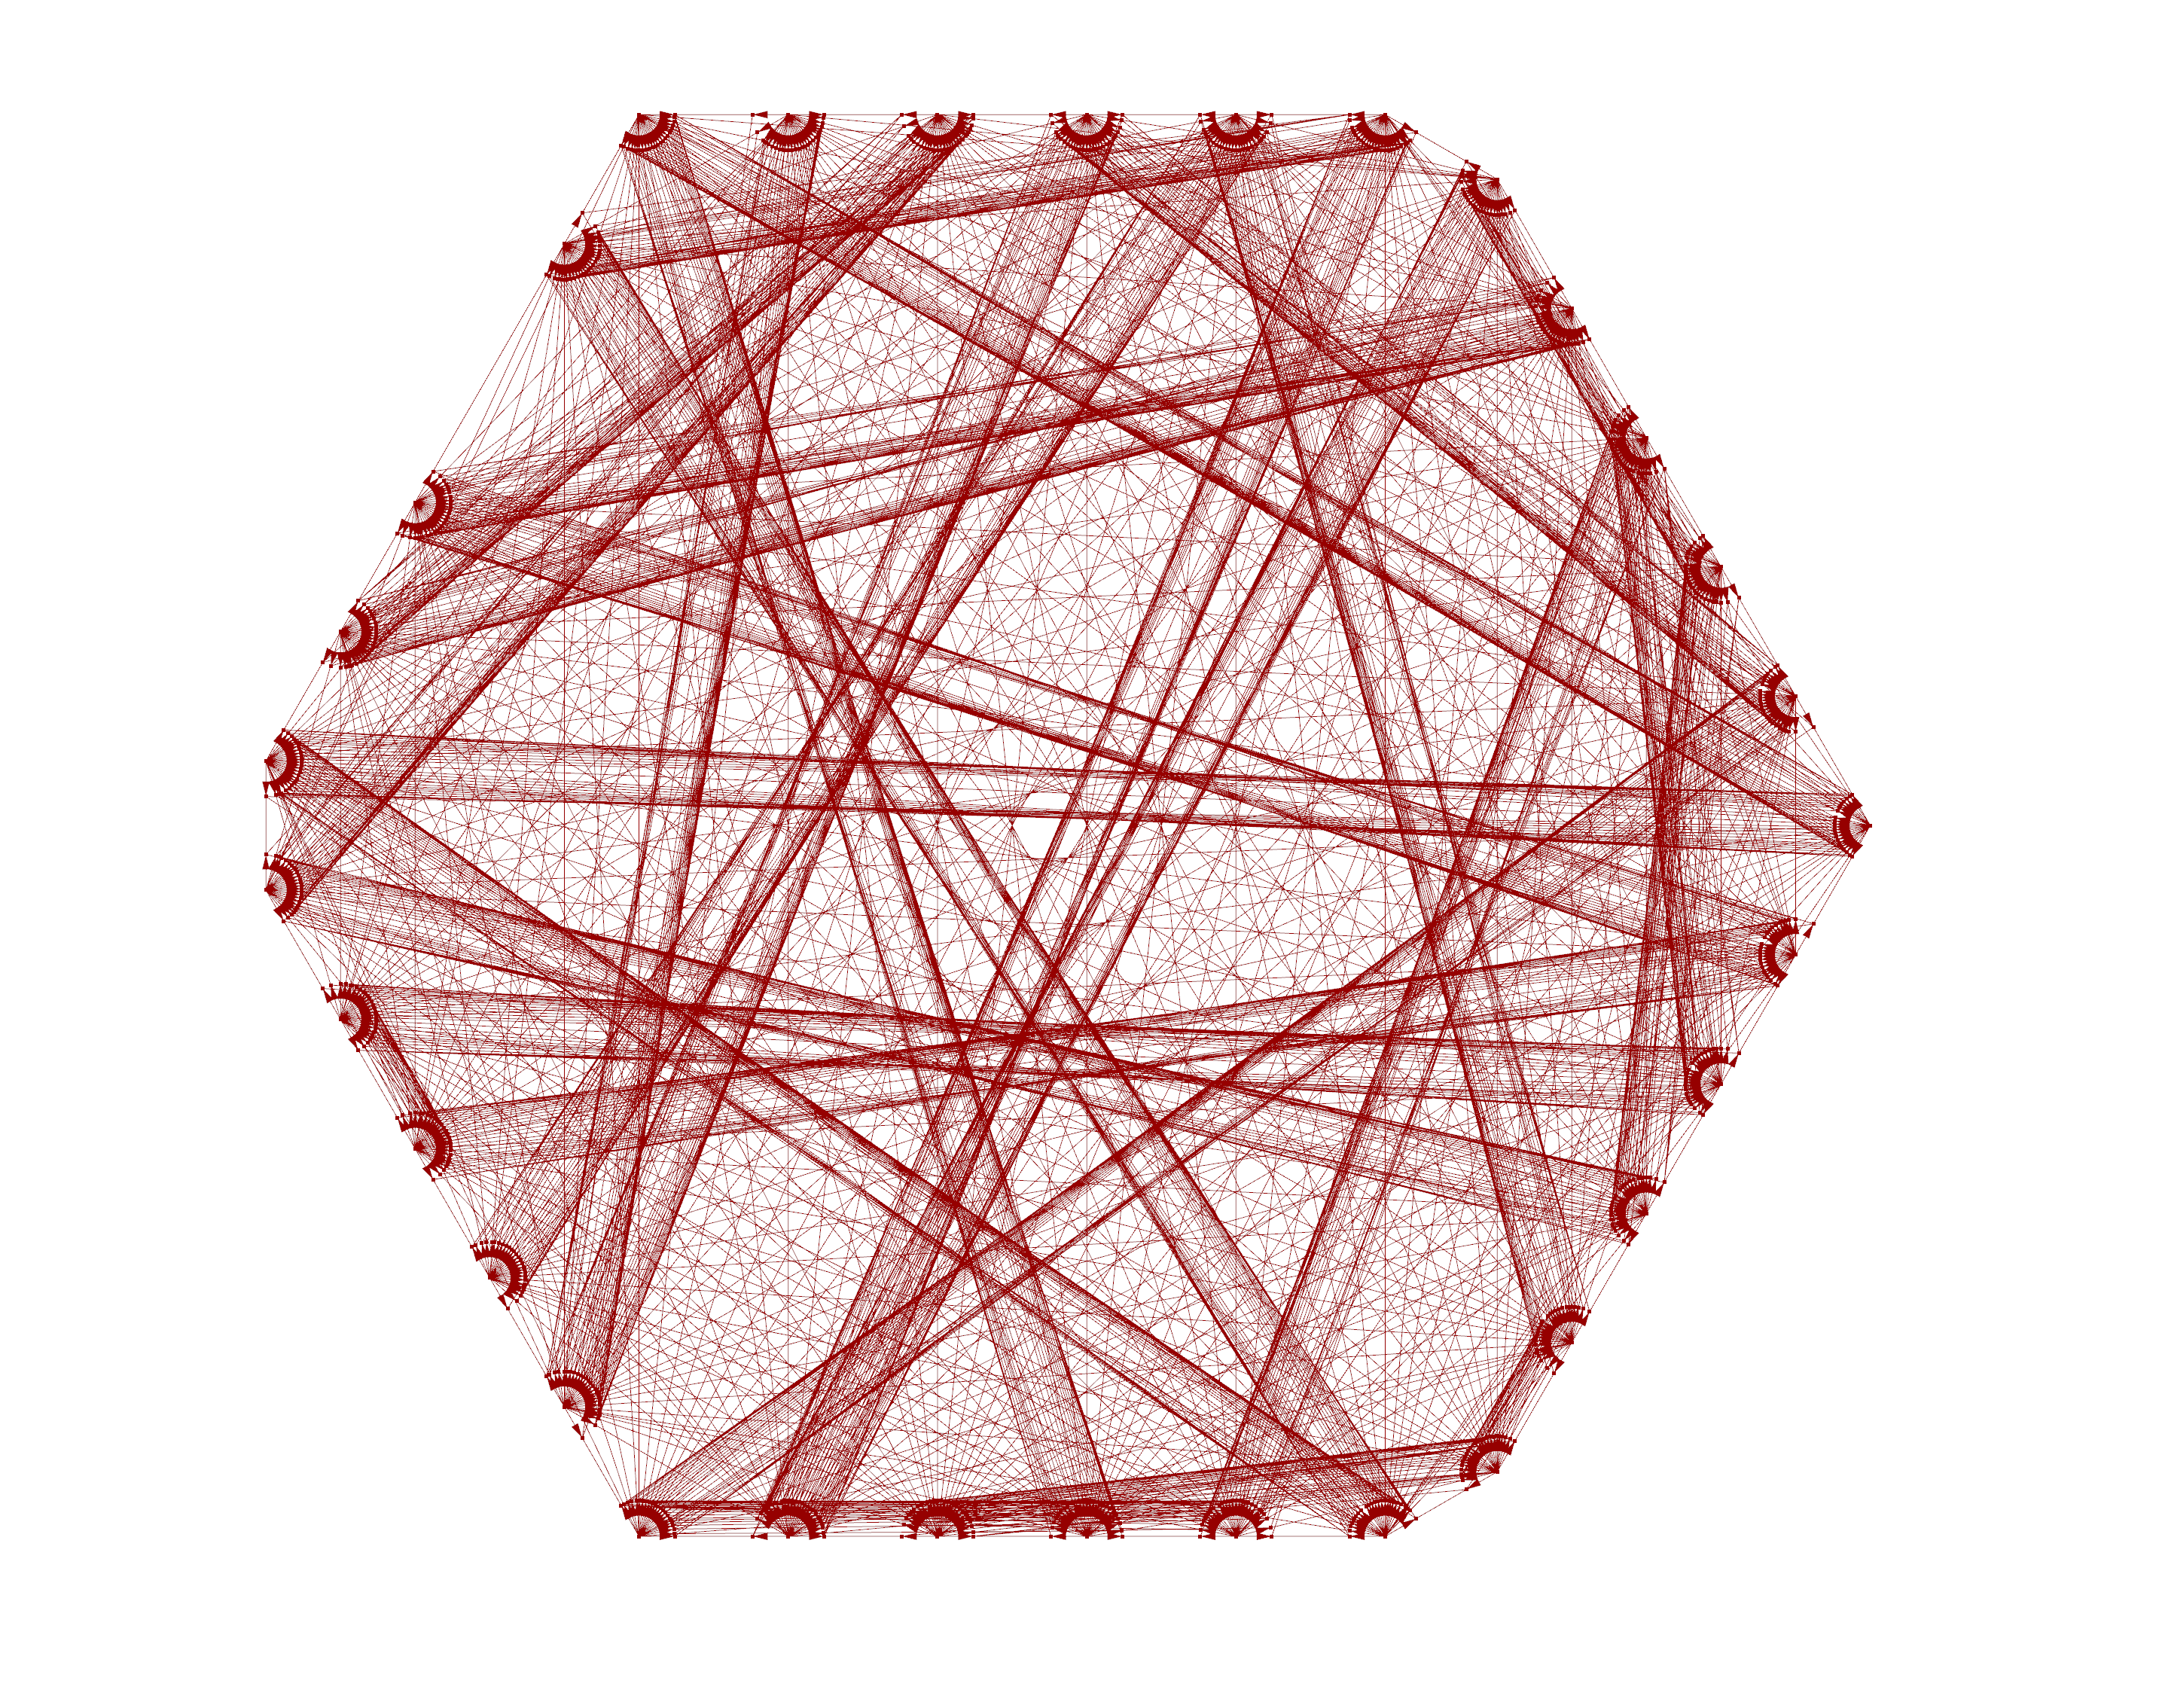
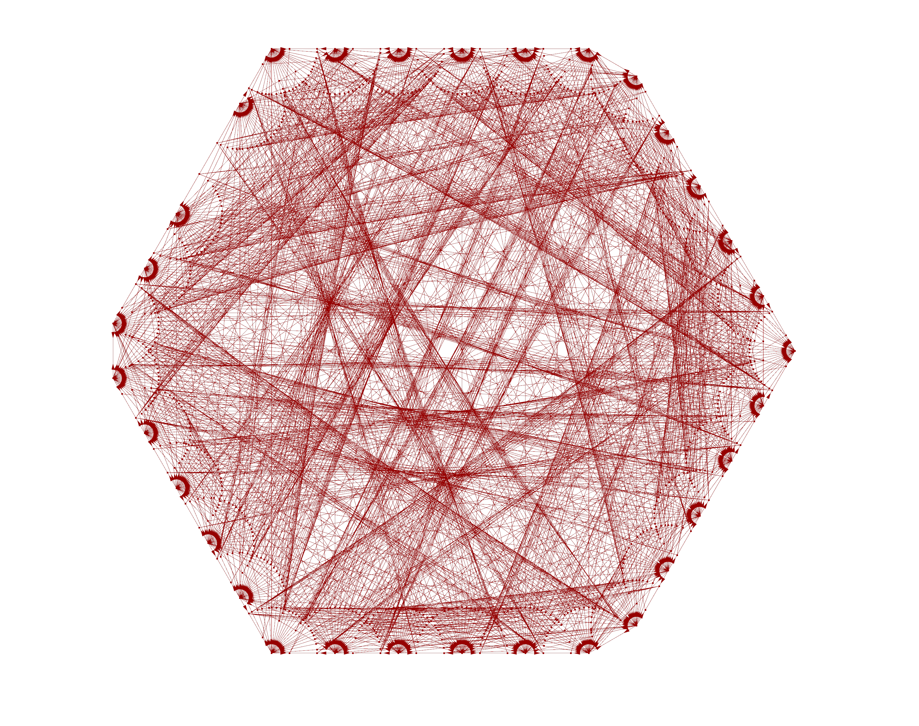

Slide 7
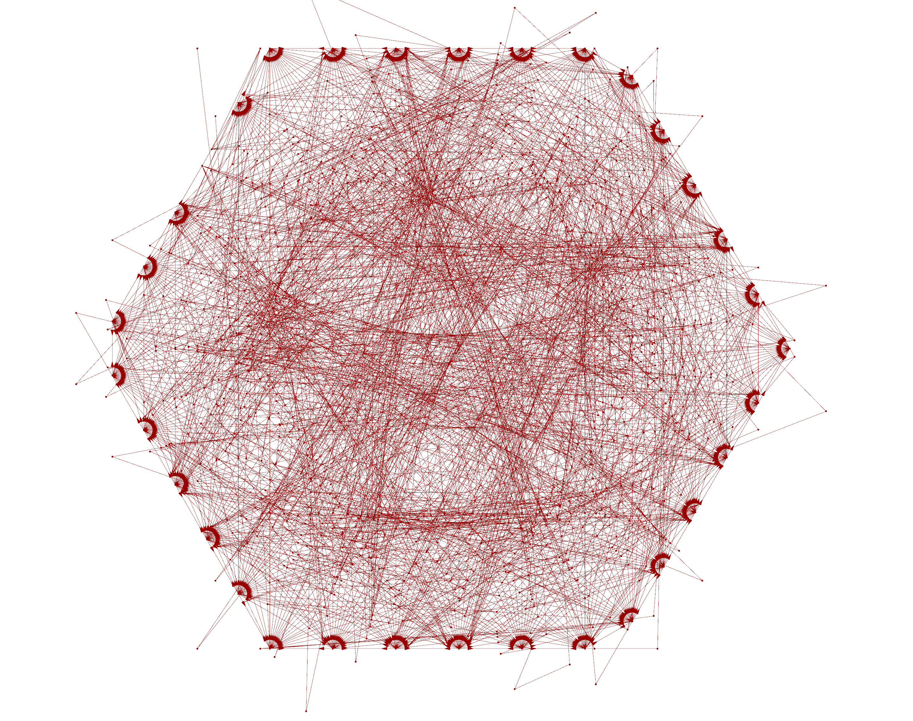
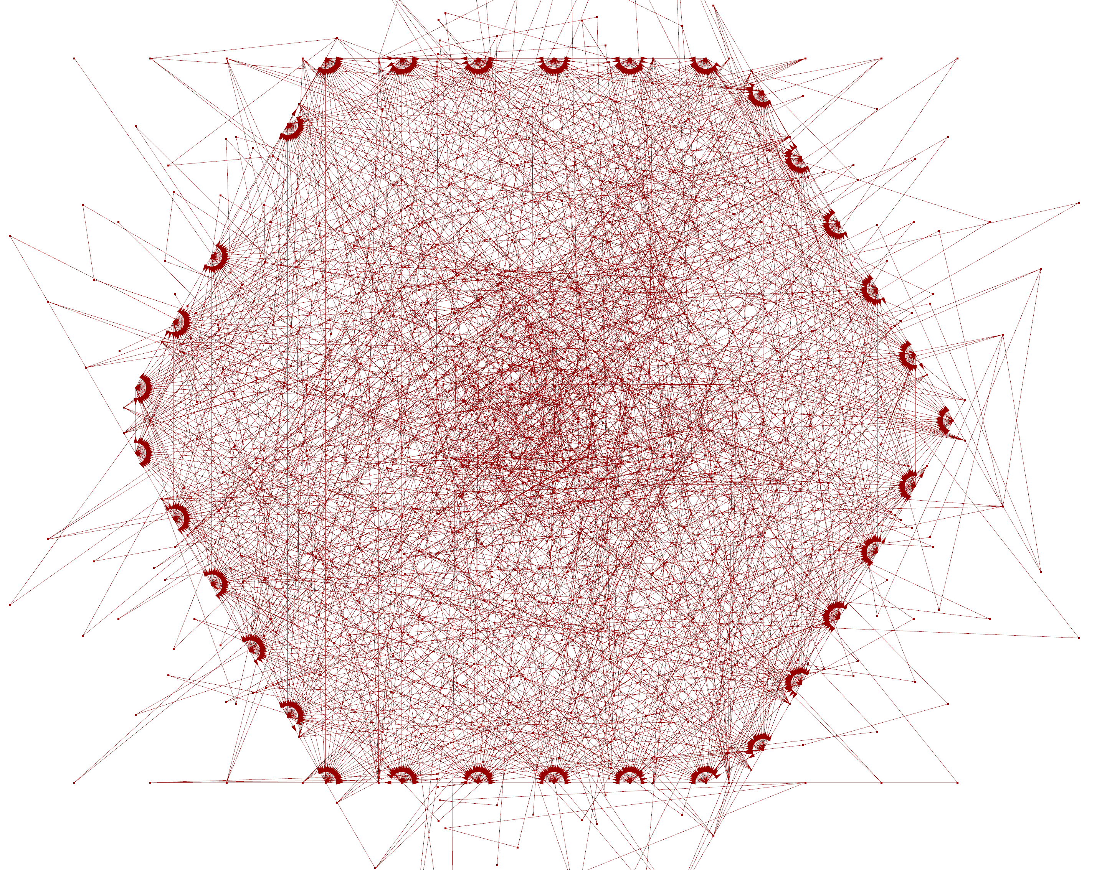

Slide 8
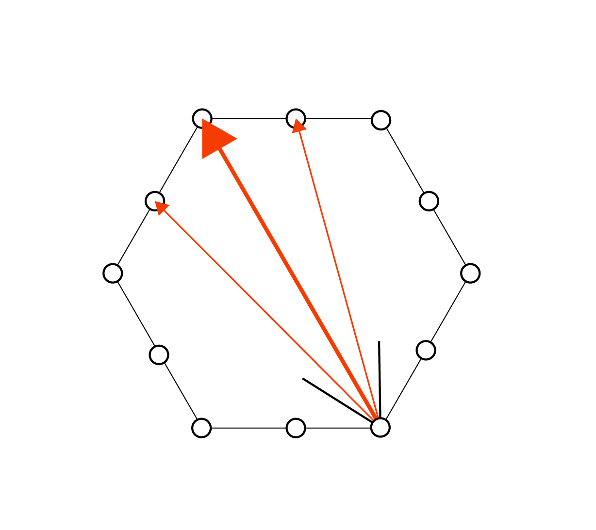
Phase 1
Sources along a fixed boundary (both in 2D and 3D)
Each source generates only one agent
The agent has one specific target, that is the furthest agents’ source with respect to its origin and is inside its visual cone

Slide 9
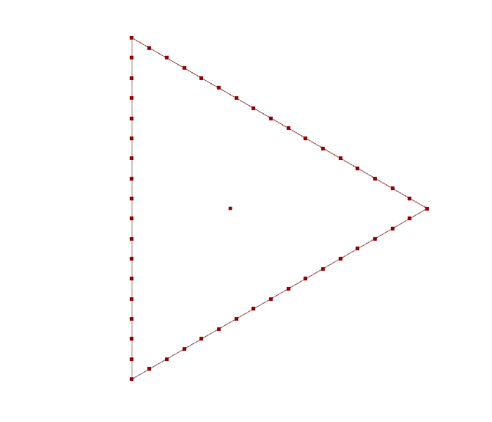
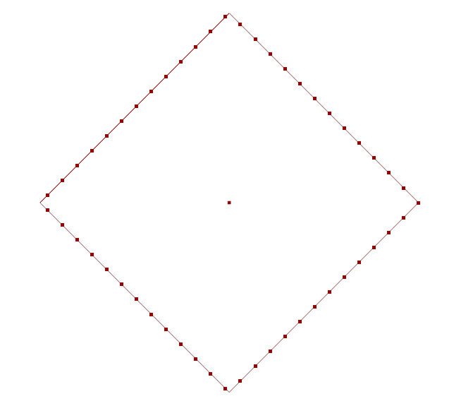

Slide 10
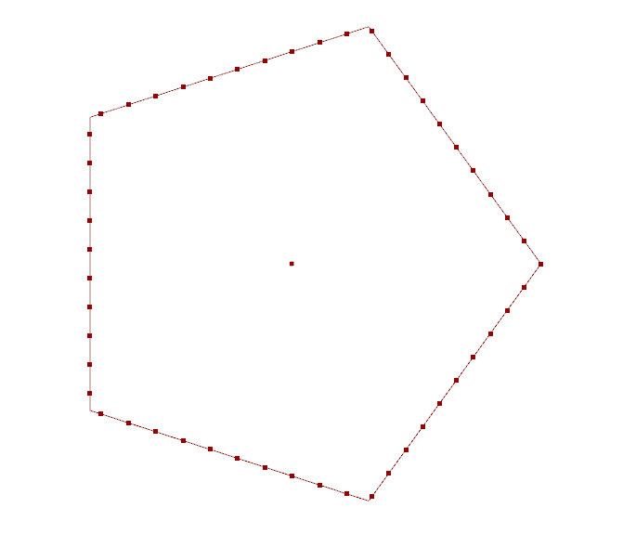
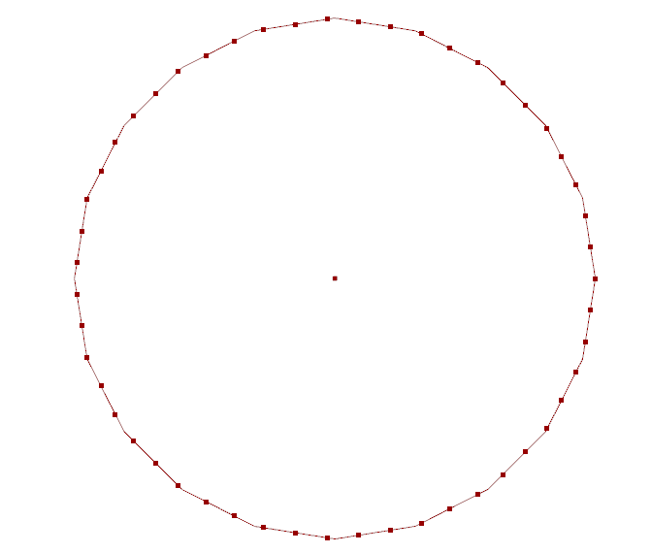

Slide 11
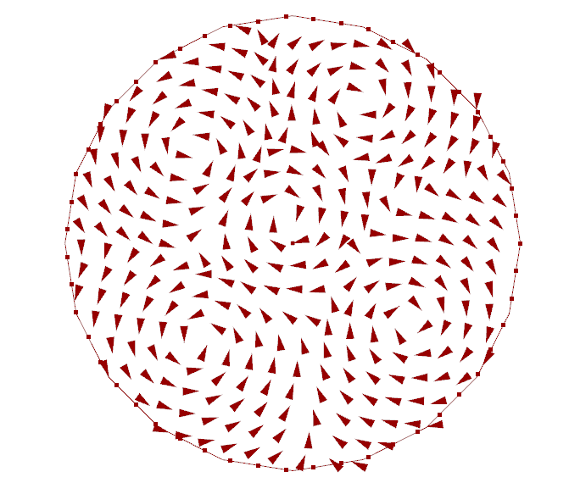

Slide 12
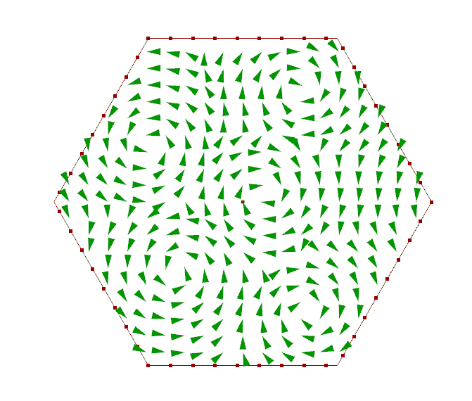

Slide 13
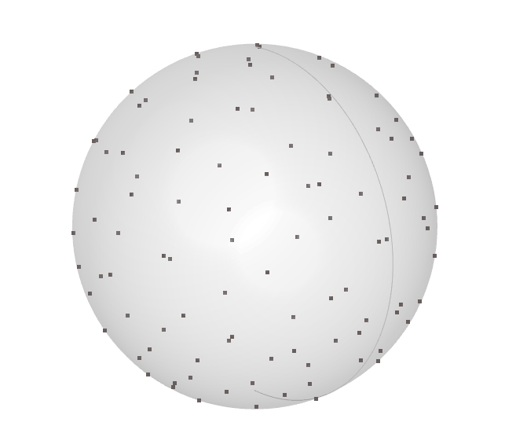
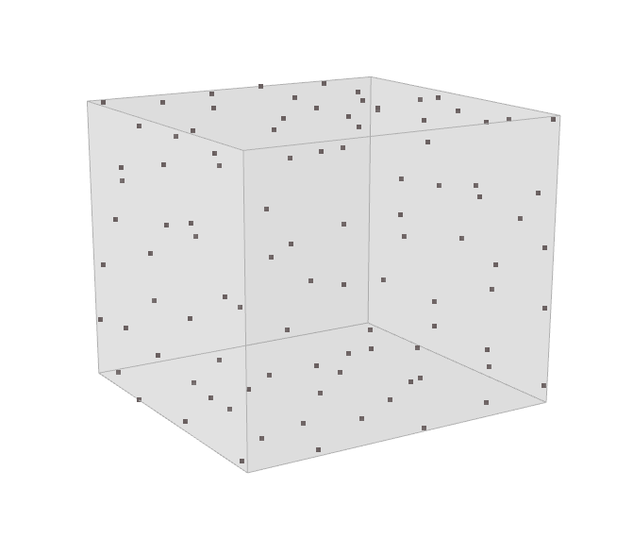

Slide 14
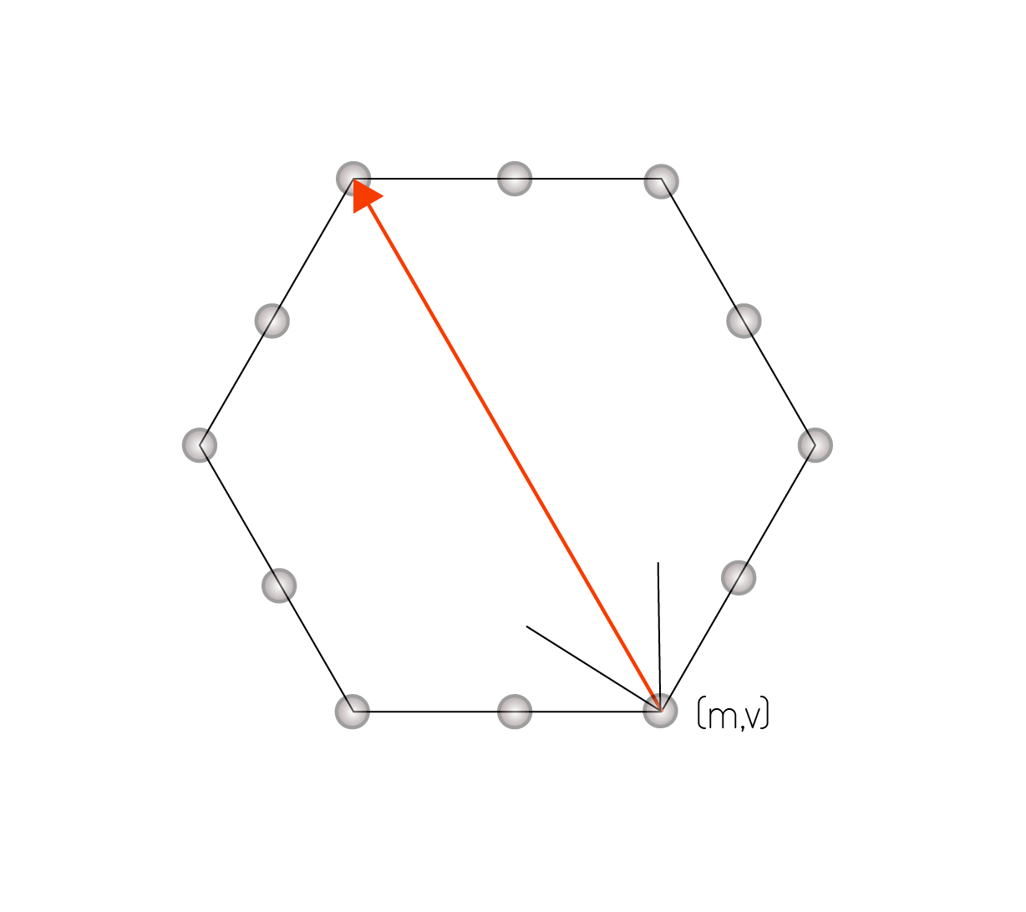
Phase 2
Each agent has an assigned random value of mass, that is used in the acceleration evaluation process (a=F/m) and in the gravitational force evaluation process, between two agents (F_{G}=Gm₁m₂/r₁₂²)
The agents are visualized as spheres (instead of points), with the center in the agent’s position and the radius corresponding to their mass
For each time step, along with the location update also a velocity check is running: if it is higher than a user input value (M_{v}), the velocity is automatically scaled to the maximum value

Slide 15
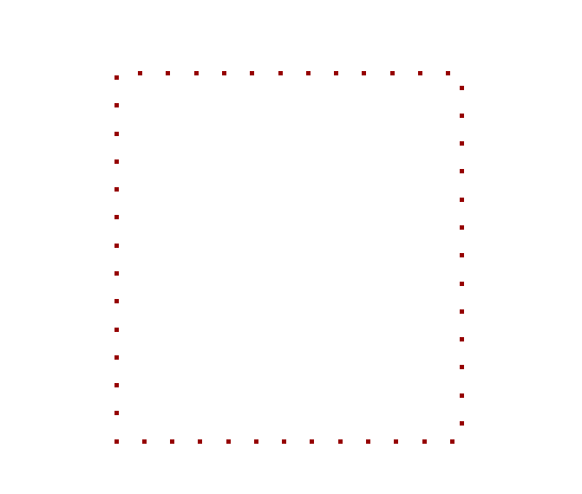

Slide 16
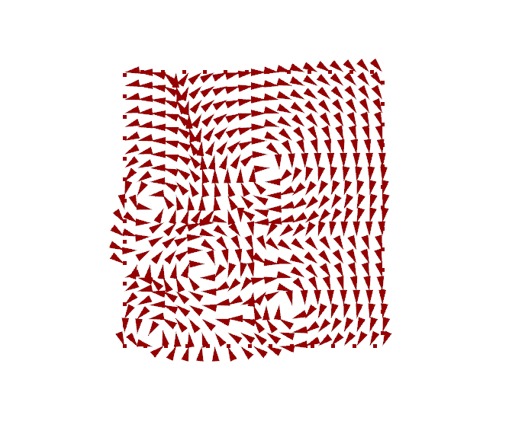

Slide 17
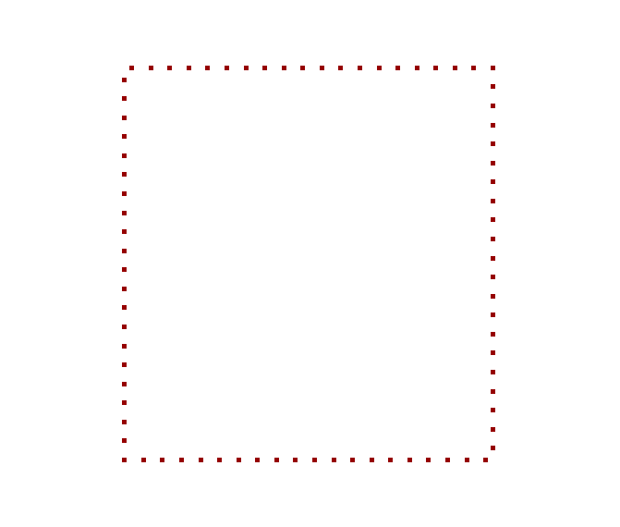

Slide 18
Phase 3
Each agent’s path is also altered by the influence of the agents in the visual cone
Other agents’ velocity inside the cone is averaged and applied with a reducing factor as a steering force to the agent
The agent is then altered in the path by the agents in the visual cone, reproducing the storm behavior

Slide 19
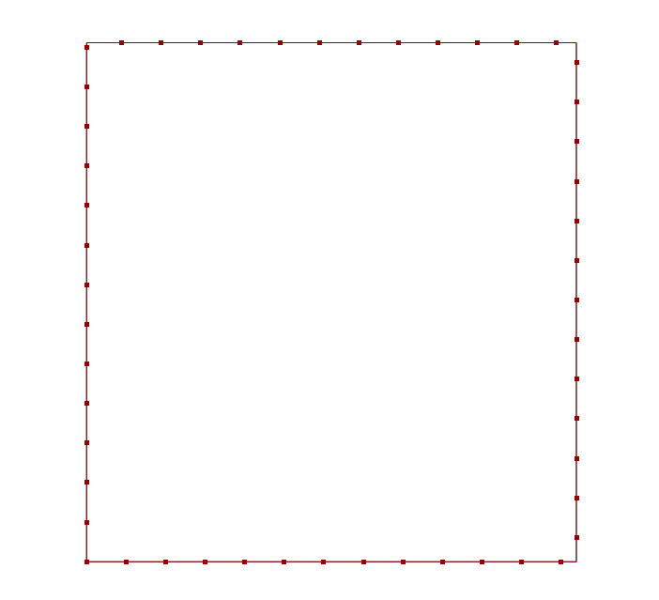

Slide 20
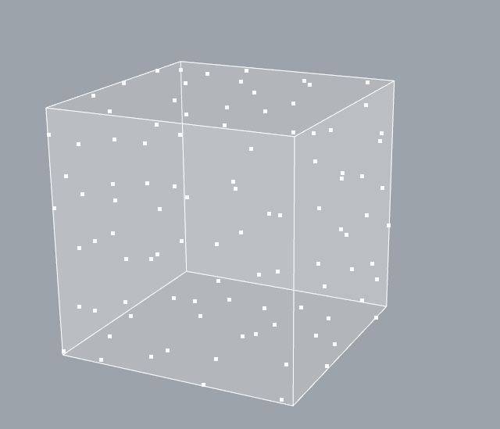

Slide 21
Approach 2

Slide 22
Phase 1
Apply the agent-based model to create a 3D surface, conceptually seen as a lightweight steel shelter
From the structural point of view, the model is based on two sources at the base of the surface, that generate a user-input number of agents, which movement is governed by the attraction with respect to the opposite source, as well as the adherence to the selected surface

Slide 23
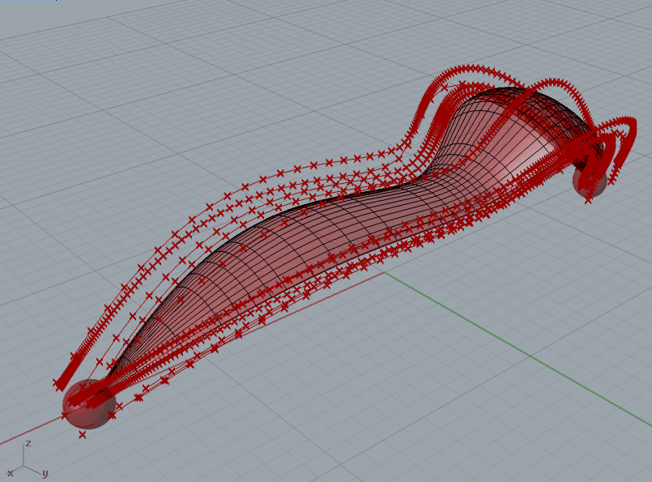

Slide 24
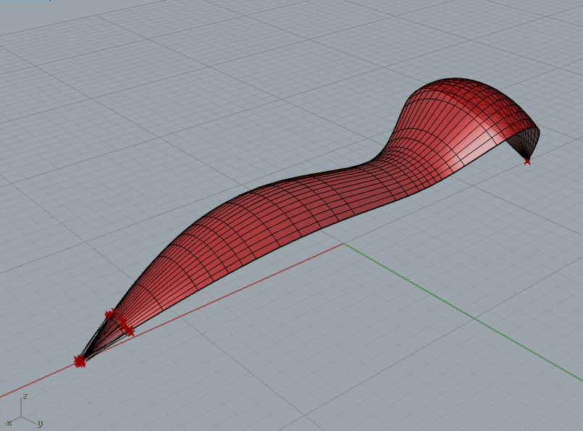

Slide 25
Phase 2
Differentiate the types of agents created by the two sources: one type is in charge of model the shape of the 3D shelter, while the other one is in chare of model the reinforcement of it
The first type’s agents have specific motion laws, such as the adherence to the surface, the attraction to the other source (seen as a target) and the repulsion with respect to each other agent
The second type’s agents differ from the previous one, as they change in motion based also on an additional spin vector applied

Slide 26
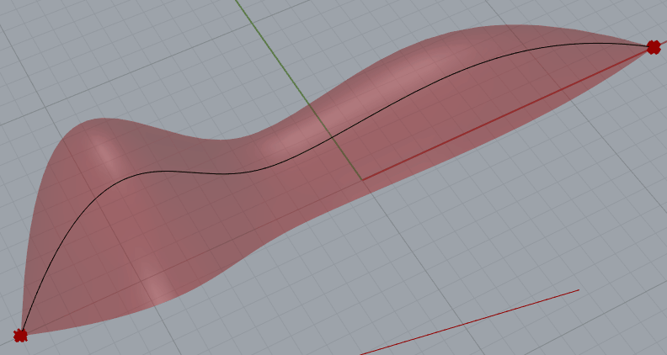

Slide 27
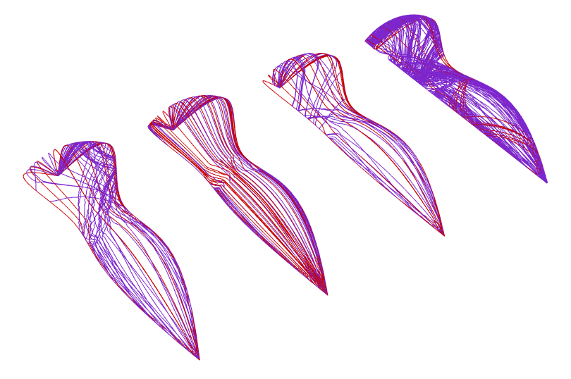

Slide 28
Phase 3
Structural analysis of the 3D shelter
Export the Rhino results (in terms of agents path) and import in FEM software

Slide 29
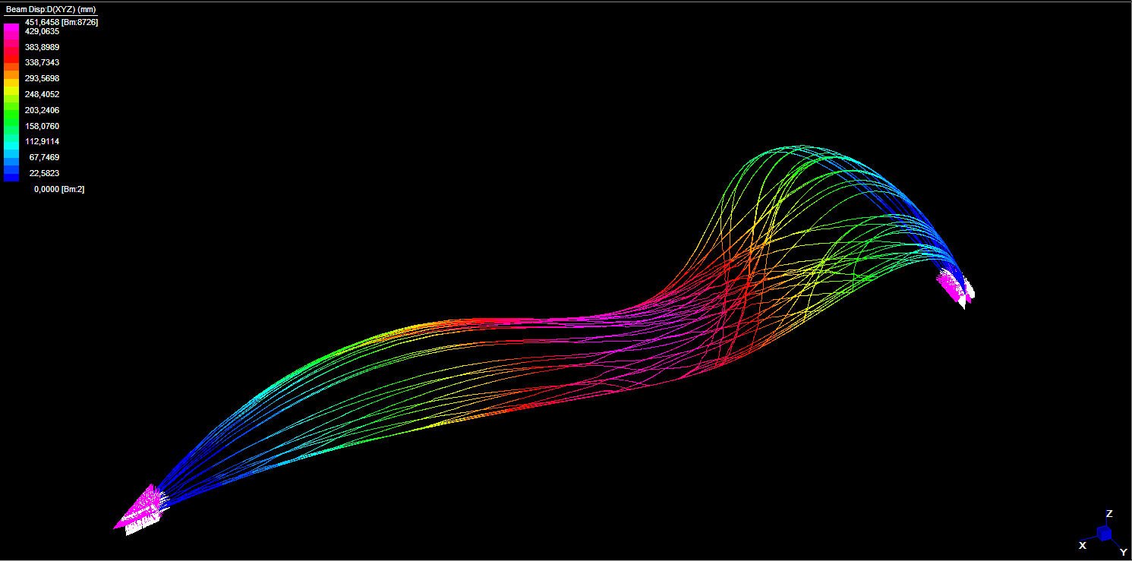

Slide 30
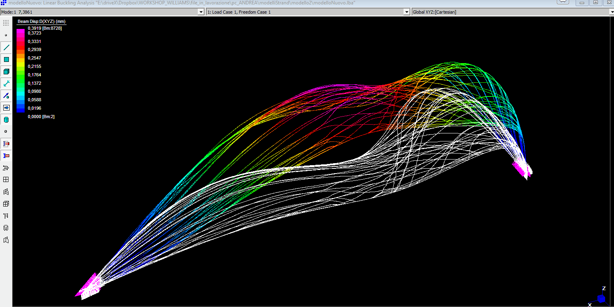

Slide 31
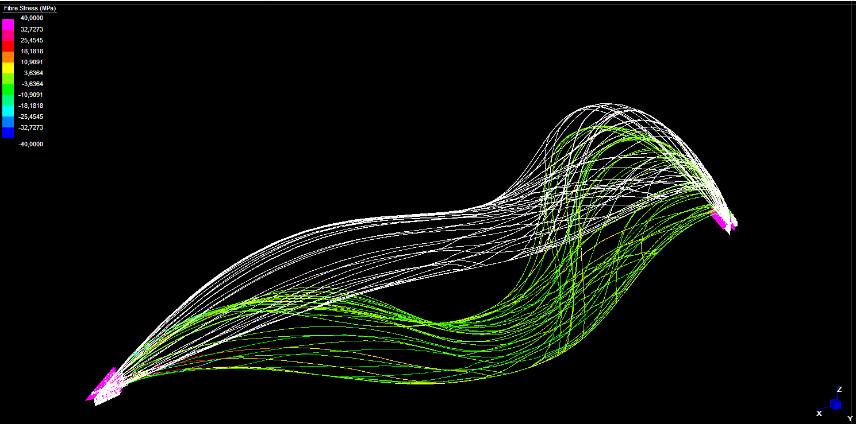

Slide 32
